Slide 1


Slide 2
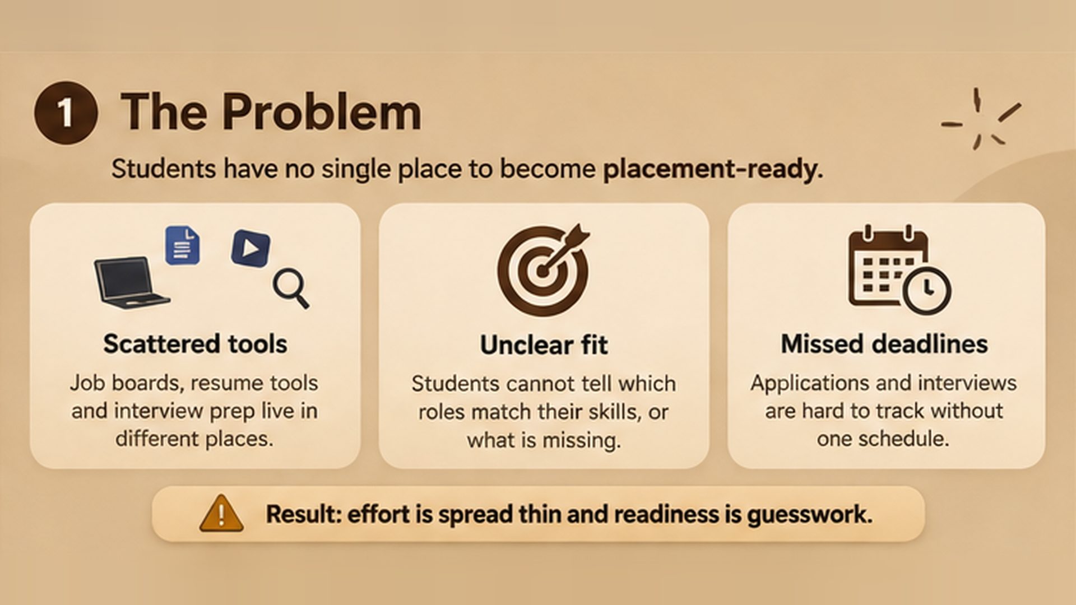

Slide 3
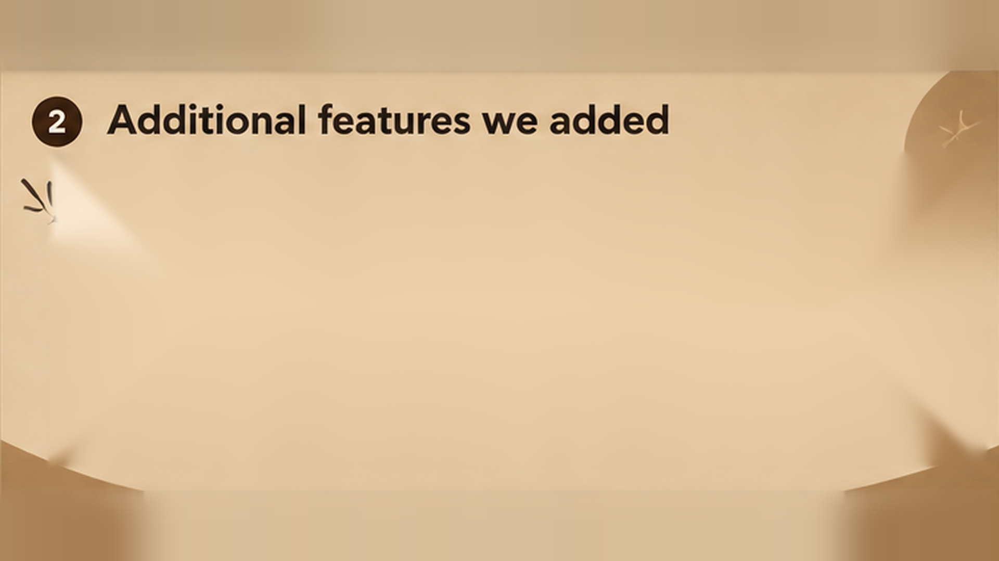








Secure login & sign up
Student ID or email access, password strength check, SHA-256 hashed storage and sign-out.
Readiness dashboard
Readiness score, ATS-verified status, detected skills, active applications and upcoming drives.
Resume upload & parsing
PDF, DOCX or TXT read right in the browser, with skills auto-detected. Sample resume included.
Job matching
Ranked roles with match %, skill gaps, a Top AI Match tag and 8 domain filters.
PDF resume studio
5 templates, live A4 preview, AI resume audit, and print or export to PDF.
Tailor & cover letter
Professional, Enthusiastic or Technical tone, AI bullet upgrades and student sign-off.
Calendar & tracker
Drive calendar with deadlines, plus a pipeline: Saved, Applied, Interview, Offer, Rejected.
Mock interview & Gemini
STAR-based scorecard from a strict hiring manager, plus a Gemini AI Co-Pilot chat.

Slide 4
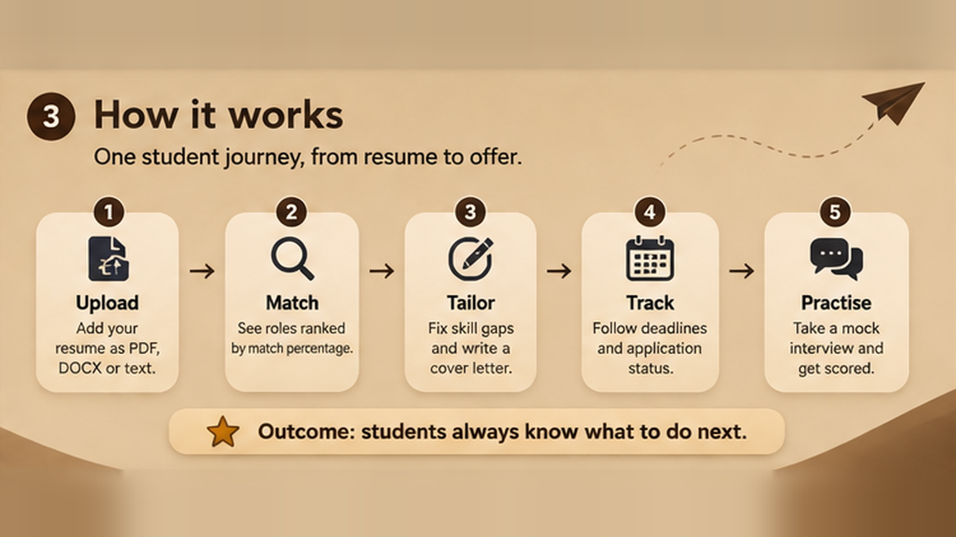

Slide 5
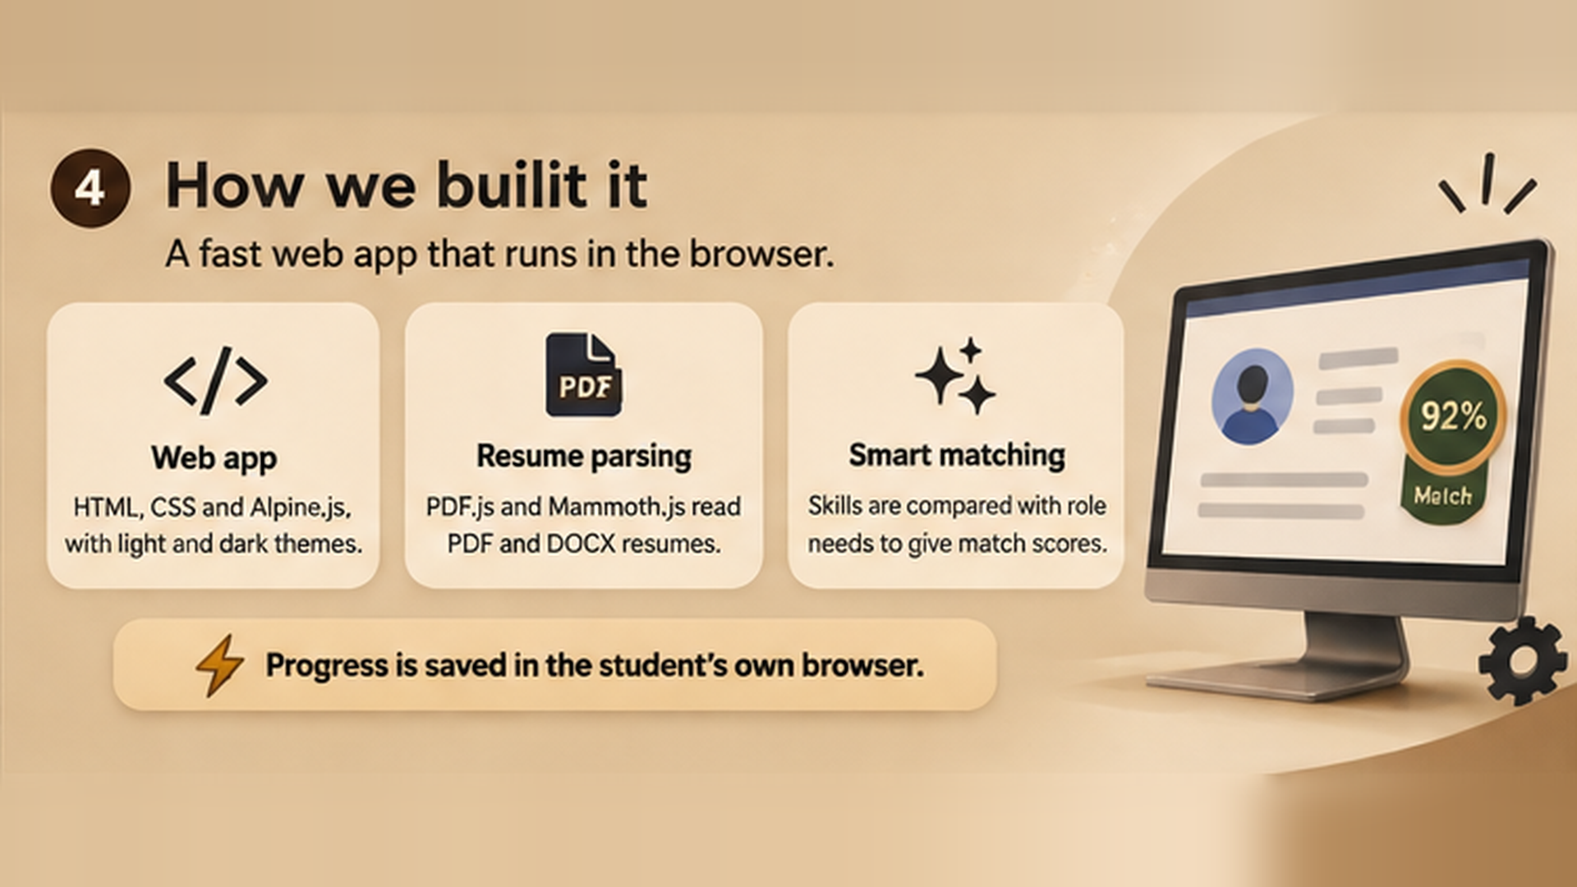

Slide 6


